Slide 1
Team Member Attenadence Data Analysis
Human Resource Dataset

Slide 2
Dataset
Statistical/Hypothetical Question
The dataset I selected was Human Resource data. I chose this dataset because HR data doesn’t seem to be examined closely or often and I think there is a lot of information a company can use to improve work force and output. When we do see analysis of this type of data, we often look at comparison in salary between different groups. My initial analysis was headed down the same path, however, the more I dug into the dataset, I decided to try to use the data to determine if there were certain variables or factors that may contribute or predict team members that have higher absence or poor attendance.
Therefore, my statistical / hypothetical question is: ‘Are there variables or attributes in employee data that influence team member attendance either positively or negatively?’

Slide 3
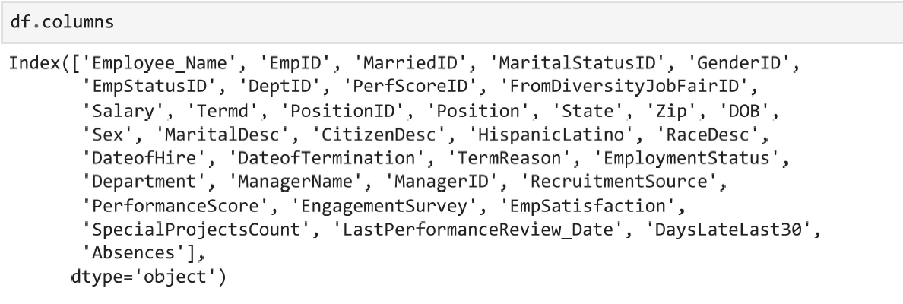
1) A minimum of 5 variables in your dataset used during your analysis.
The HR dataset I chose contains 36 variables about employee information. The variables are listed below:
The 5 variables I used most in my analysis were:
Absences, Salary, Employment Status, Employee Satisfaction, Engagement Survey.
Although I did explore further and examine other variables such as:
Gender, DeptID, MarriedID, SpecialProjectsCount, and ManagerID

Slide 4
2) Describe what the 5 variables mean in the dataset (Chapter 1).
Variable 1 – Employment Status is a description/category of the person’s employment status. This comes important to evaluate if the team member is still employed at the company
Variable 2 - Engagement Survey are they results from the last engagement survey. This lists the results of the engagement survey and may provide insight to how engaged team members are with their job responsibilities. This might lead into how well team members are performing their jobs or how well they do their jobs.
Variable 3 - Employee Satisfaction is a basic satisfaction score between 1 and 5, as reported on a recent employee satisfaction survey which can provide detail on how well employees like their jobs. This can be used to determine what other attributes or varibales are more or less satisified with their employment.
Variable 4 - Salary the person’s yearly salary. $ U.S. Dollars. This can be used to compare differences in pay between other attributes or variables and potentially what variables influence a team members salary (absences, department, sex, marital status, etc)
Varibale 5 - Absences is the number of times the employee was absent from work. We can use this to compare what other variables have an impact on employee absences, how their pay is influence, if they are more engaged or satisfied with their work, etc.

Slide 5
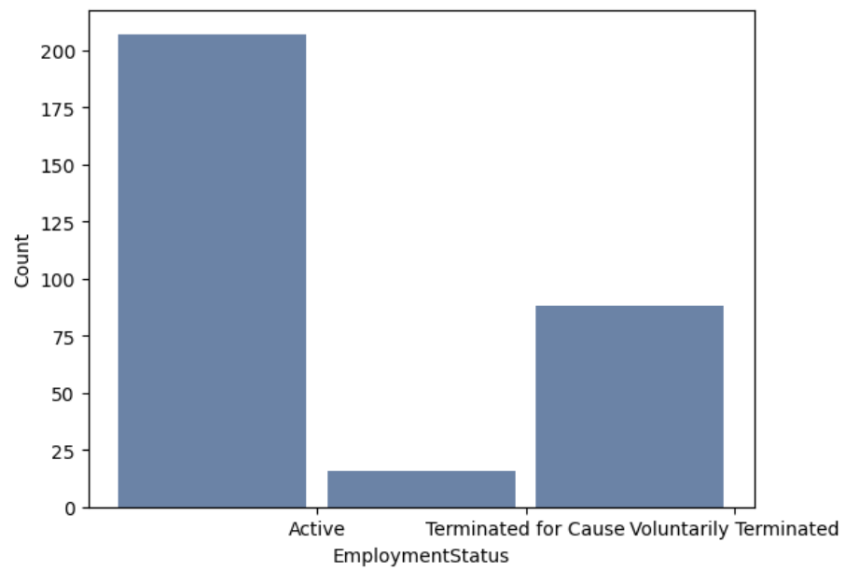
3) Include a histogram of each of the 5 variables – in your summary and analysis, identify any outliers and explain the reasoning for them being outliers and how you believe they should be handled (Chapter 2). 4)Include the other descriptive characteristics about the variables: Mean, Mode, Spread, and Tails
Histogram 1 – Employment Status
This isn’t really a histogram, but more of a bar chart, however, I felt it was necessary to view.
Employment Status, shows the distribution of the employees in the data set that are still actively working and those that were terminated or voluntarily left the company.
The mode of the dataset is still actively working. This variable is of Boolean value, so there is no mean but the benefit of this dataset is to view the number of workers that are still actively contributing information / data to the data set.
Furthermore, correlations can be conducted to determine the satisfaction rates, engagement surveys, absences, and salary differences between the active employees, employees that were terminated, and employees that have voluntarily left the company

Slide 6
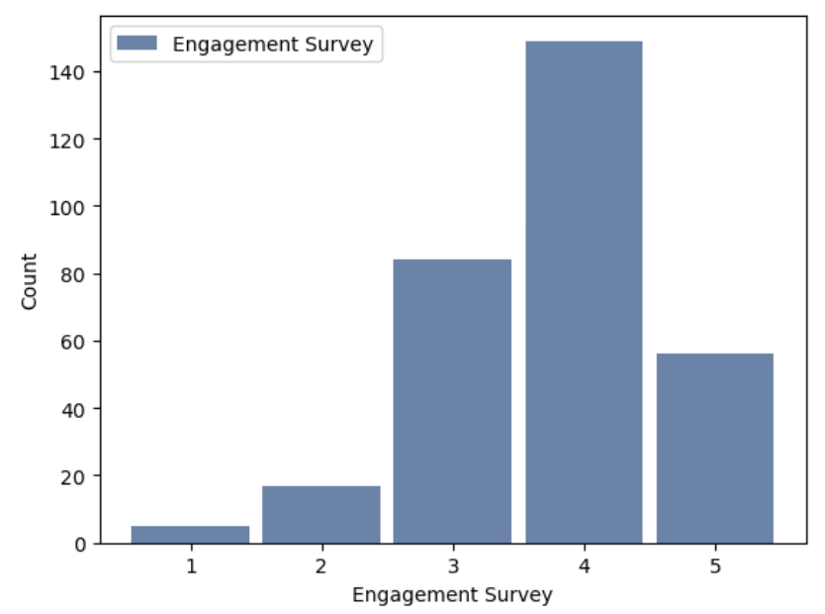
3) Include a histogram of each of the 5 variables – in your summary and analysis, identify any outliers and explain the reasoning for them being outliers and how you believe they should be handled (Chapter 2). 4)Include the other descriptive characteristics about the variables: Mean, Mode, Spread, and Tails
Histogram 2 – Engagement Survey
Engagement survey shows the distribution of engagement survey results.
Engagement survey result mode is peaking around 4 with a small skew to the bottom side / left.
The mean is 4.11 which indicates most of the values in the engagement survey were above satisfactory.
The engagement survey results assess the participation of the workers in the survey with the max value at 5.0 (assuming a perfect score) and min value of 1.12.
Therefore, the spread is not great, however it highlights the participation of the workers.

Slide 7
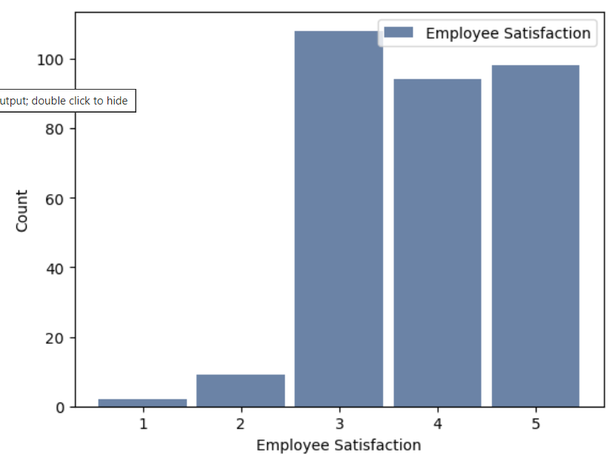
3) Include a histogram of each of the 5 variables – in your summary and analysis, identify any outliers and explain the reasoning for them being outliers and how you believe they should be handled (Chapter 2). 4)Include the other descriptive characteristics about the variables: Mean, Mode, Spread, and Tails
Histogram 3 – Employee Satisfaction
Employee satisfaction is a tool to provide feedback for employers to assess their teams overall satisfaction of their job.
The grade scale of the satisfaction survey is from 1 - 5 with a 1 being completely unsatisfied and 5 being completely satisfied.
This data shows that most people are neutral to mostly satisfied with neutral being the mode. The mean of this variable is 3.89 which indicates most of the team members tip right on the edge of neutral to somewhat satisfied with their position with a few team members that are not satisfied.
This histogram is not evenly distributed with heavy weighting to the left, further supporting the mean and conclusion mentioned earlier.

Slide 8
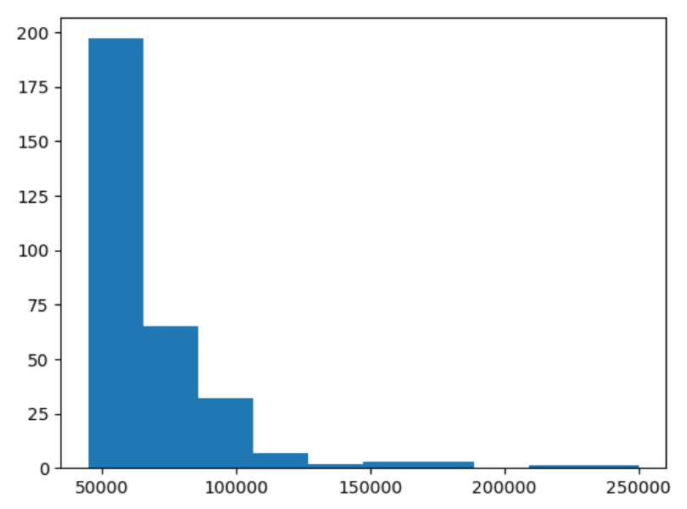
3) Include a histogram of each of the 5 variables – in your summary and analysis, identify any outliers and explain the reasoning for them being outliers and how you believe they should be handled (Chapter 2). 4)Include the other descriptive characteristics about the variables: Mean, Mode, Spread, and Tails
Histogram 4 - Salary
The distribution shows most of the team members at the lower end of pay scale around the $50,000 range and a few team members in the upper end. This isn’t surprising, considering
The spread is quite vast with the pay scale from $45000 - $250000.
The mean value of the variable is just shy of $70,000 which is a good looking average, however this mean can be misleading with the distribution skewed with outlier values at the extreme top end of the pay scale.
This is supported by the mode which stands around the $50,000 dollar mark.

Slide 9
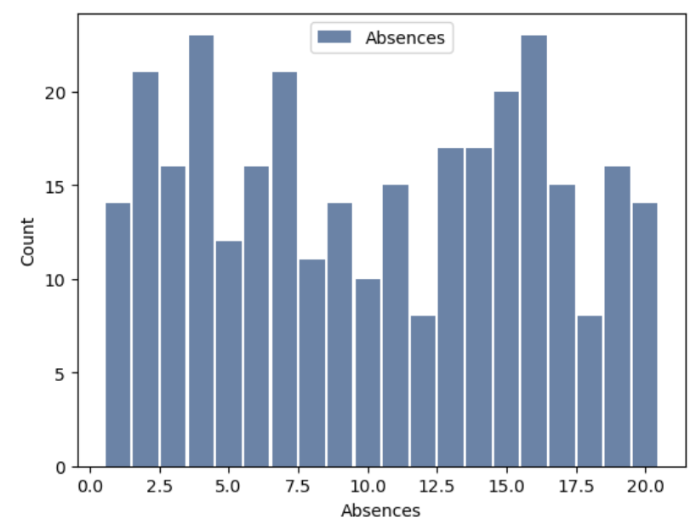
3) Include a histogram of each of the 5 variables – in your summary and analysis, identify any outliers and explain the reasoning for them being outliers and how you believe they should be handled (Chapter 2). 4)Include the other descriptive characteristics about the variables: Mean, Mode, Spread, and Tails
Histogram 5 - Absences
This histogram shows the distribution of team member absences.
This is not an even distribution of values with peaks and values throughout the data set. There does not seem to be a mode that really stands out between 4 and 16.
The range is from 0 to 20, so this indicates that after 20 absences, the employee may be subject to termination as there are no further values past 20.
Also, different peaks in the dataset may indicate different levels of discipline i.e. written warnings, level one discipline, level two, and so on.
The mean sits right in the middle of the range at 10.2 absences per team member, which still seems high. It would be interesting to see how absences compare to salary, satisfaction ratings, engagement, position, gender, and so on.

Slide 10
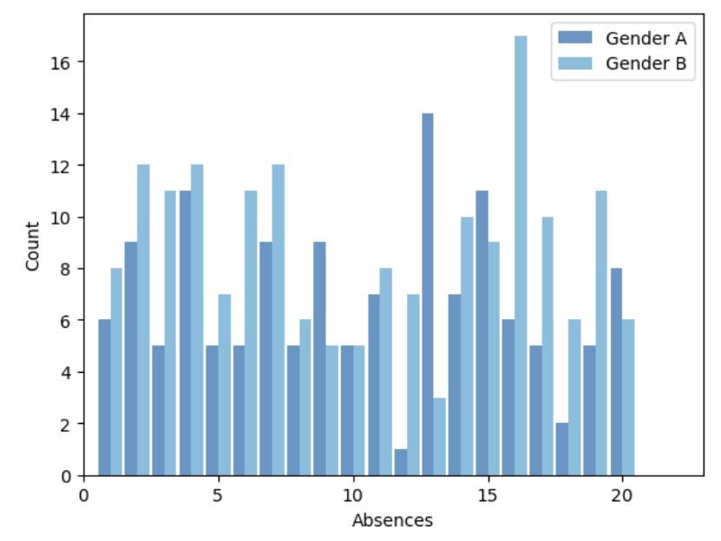
Because my first “histogram” was more like a bar chart, I decided to dive deeper into the absence variable, and it helped me formulate my project around what conditions or variables contribute to team member absence. With this histogram, I split out absences by gender to see if there was a difference in the distribution between gender A and gender B.
Histogram 6 – Absences by gender
With this histogram, i split the difference in employee absences between gender A and gender B.
Gender B has a lot more absences (1806) than Gender A (1378), however the mean of both genders is about the same. (10.2)
The distribution shows that the number of absences are distributed evenly until we get to those employees with 10 or more absences. There seems to be a bigger separation between the two at the 12, 13, 16, 17, and 19 values, however one may speculate what this means.
Absences can be a result of many reasons, so correlation with these values and trying to compare between genders with this data doesn't really force us to favor one or the other.

Slide 11
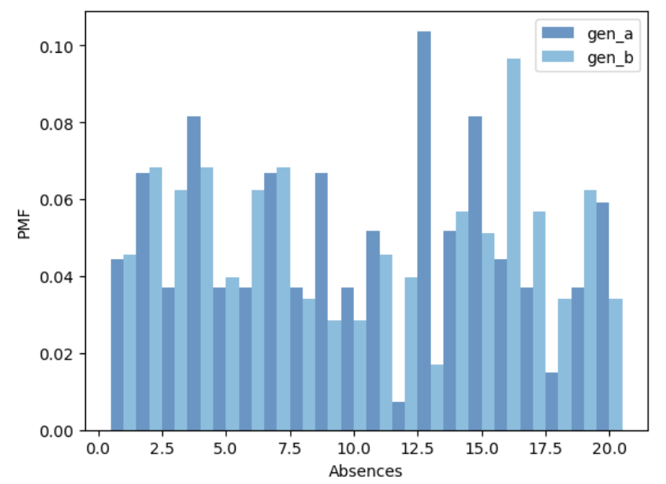
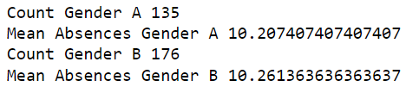
5) Using pg. 29 of your text as an example, compare two scenarios in your data using a PMF.
Scenario 1
PMF of Gender / Absence

Slide 12
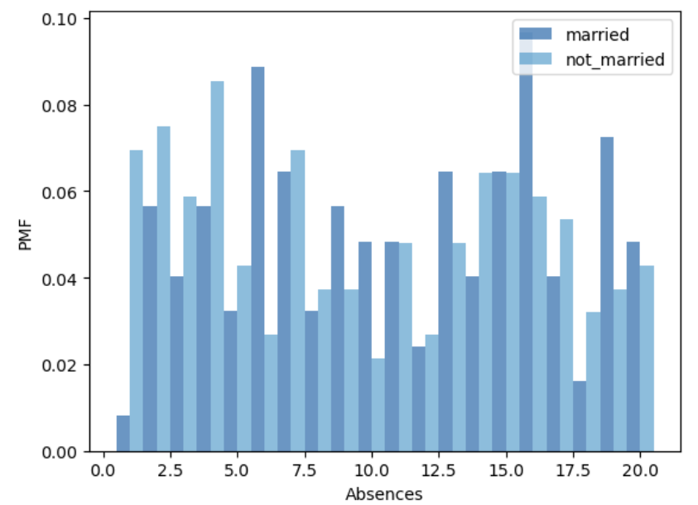
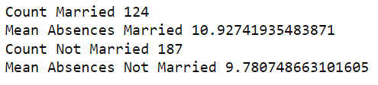
5) Using pg. 29 of your text as an example, compare two scenarios in your data using a PMF.
Scenario 2
PMF of Married ID / Absence

Slide 13
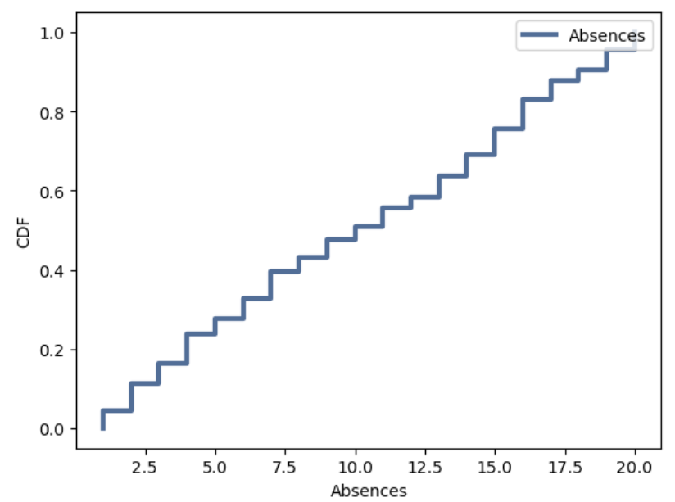
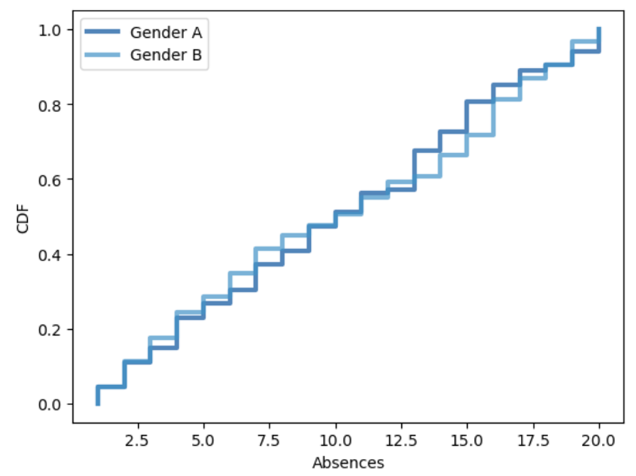
6) Create 1 CDF with one of your variables, using page 41-44 as your guide, what does this tell you about your variable and how does it address the question you are trying to answer CDF of Absences This comparison CDF makes the shape of the distribution and the differences between them much clearer. While Gender A seems to have less absences up to the mean of 10, the number of absences rises above Gender B above that point. Gender B has a higher absence level under 10 absences but seems to increase after that point.

Slide 14
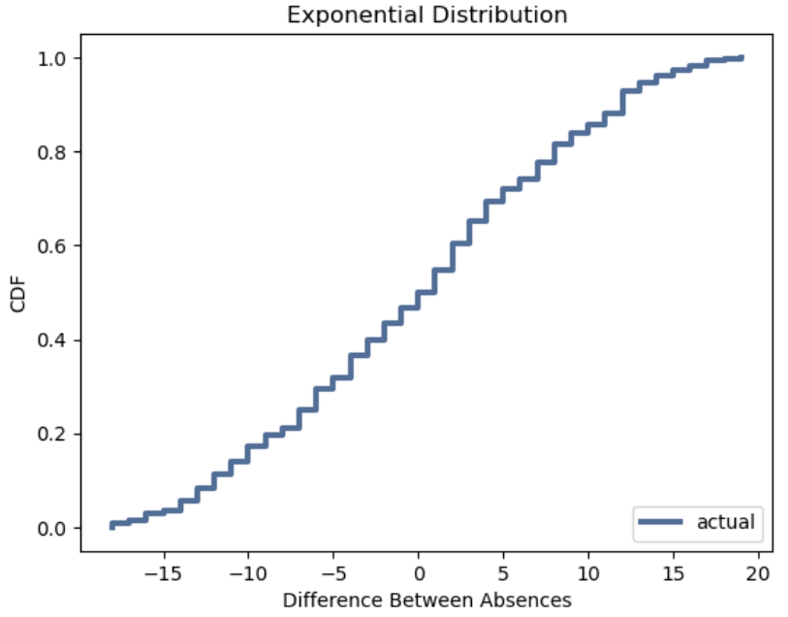
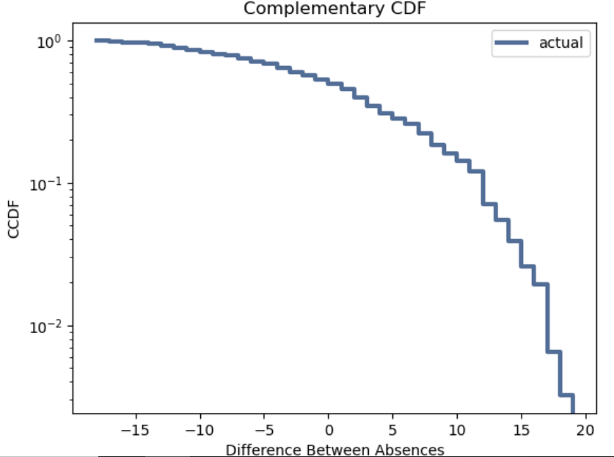
7) Plot 1 analytical distribution and provide your analysis on how it applies to the dataset you have chosen I chose exponential distribution because I wanted to see if the series of events are equally likely to occur at any time and make a curve shape of an exponential distribution. Plotting below shows a slight exponential curve. We check the exponential distribution by using a complimentary CDF. For data from an exponential distribution, the result is a straight line. In the figure below, the results is not exactly straight, which indicates that the exponential distribution for absences may not be the perfect model for this data.

Slide 15
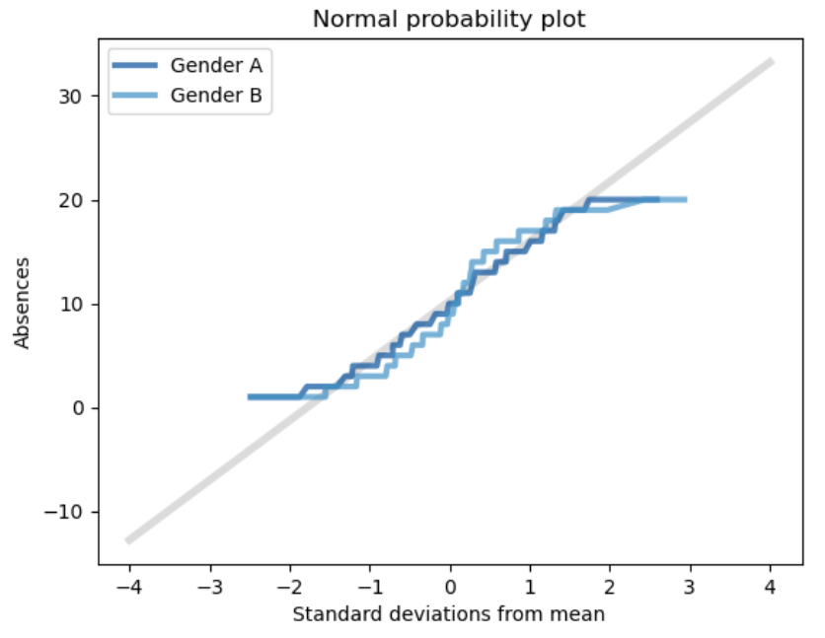
7) Plot 1 analytical distribution and provide your analysis on how it applies to the dataset you have chosen
The figure shows results for both Gender A and Gender B.
Both curves match the model near the mean but deviate at the tails.
Both genders curves are slightly lower than what the model expects below the mean and the curves are slightly higher than what the model expects above the mean.
The plot suggest that the normal model describes the distribution well for both Gender A and Gender B, within a few standard deviations from the mean, but not within the tails.

Slide 16
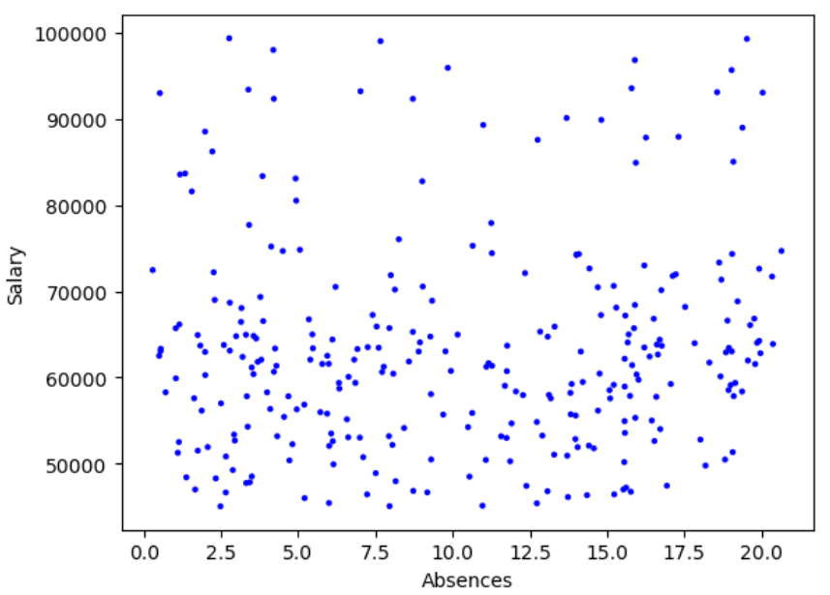

8) Create two scatter plots comparing two variables and provide your analysis on correlation and causation. Remember, covariance, Pearson’s correlation, and Non-Linear Relationships should also be considered during your analysis
Scatter Plot 1 (absences and salary) We will review to see if there is a correlation between salary and absences. One may think team members with better salary have better attendance.
In this scatter plot we filter to the salary income below $100000 which is where the bulk of our employees or data lies.
Examining the data, do not see much linear relationship in the scatter plot.
Covariance is the measure of the tendency of two variables to vary together. Below we see a positive covariance of 4880.
Correlation is a statistic intended to quantify the strength of the relationship between two variables.
The correlation below is 0.066 which is a relatively weak correlation between absences and salary OR at least with
Pearson's Correlation, there is no linear relationship between these two variables.
Spearman's Correlation of the lower income salary is slightly higher than the Pearson Correlation.
Both indicate a weak correlation between Absences and Salary or at least no linear relationship.
Therefore, one may conclude that there is no or a weak relationship between income and absences.

Slide 17
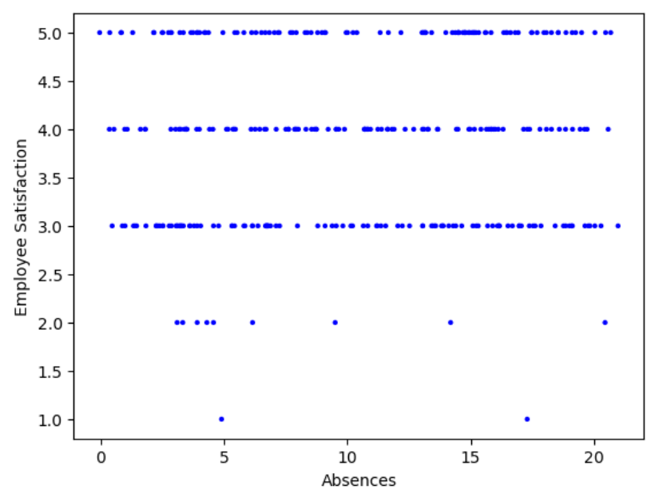

8) Create two scatter plots comparing two variables and provide your analysis on correlation and causation. Remember, covariance, Pearson’s correlation, and Non-Linear Relationships should also be considered during your analysis
Scatter Plot 2 (Absences and Employee Satisfaction Rating) Perhaps there is a correlation between absences and how satisfied a team member is with their job. One would think that employees more satisfied would have better attendance.
Review of the scatter plot below does not show much linear relationship between employee satisfaction and absences.
Team members with high satisfactory ratings seemed to have a similar distribution of absences as the team members with medium or medium high employee satisfactory ratings.
We see a positive covariance of 0.36 indicating a positive reaction between the variables.
Correlation is a statistic intended to quantify the strength of the relationship between two variables.
The correlation is 0.068 which is a relatively weak correlation between absences and salary OR at least with Pearson's Correlation, there is no linear relationship between these two variables.
Spearman's Correlation of the lower income salary is slightly higher than the Pearson Correlation. Both indicate a weak correlation between Absences and Salary or at least no linear relationship. Therefore, one may conclude that there is no or a week relationship between employee satisfaction and absences.
Apparently even those employees that are completely satisfied with their job still miss work as much as those who are not satisfied.

Slide 18
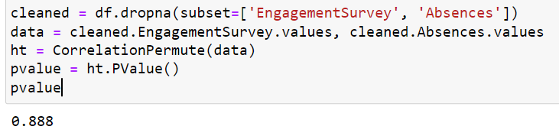
9) Conduct a test on your hypothesis using one of the methods covered in Chapter 9. The method I will use is "Testing a Correlation" on page 107 and comparing the correlation between the Engagement Survey and Absences.
The pValue between Engagement Survey and Absences Correlation test shows a relatively high p-value indicating a weak correlation between the engagement survey and absences and therefore not statistically significant. However, this may be in part that the engagement survey has a max value of 5.0 and team members completing all of the survey will reach a max value and may still have a large distribution in absences...

Slide 19
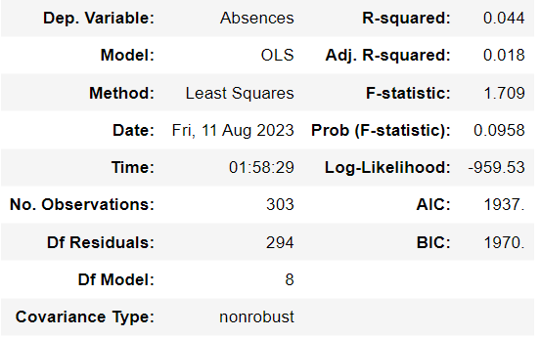
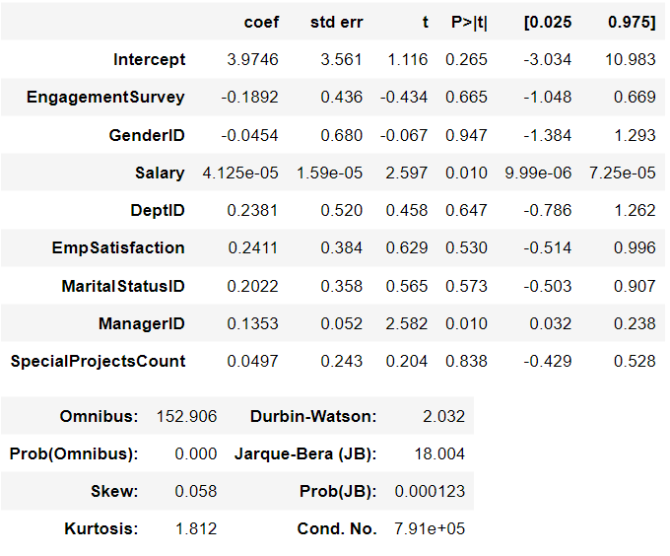
10) For this project, conduct a regression analysis on either one dependent and one explanatory variable, or multiple explanatory variables. Running multiple regression, only salary seems to have an extremely low pValue indicating statistical significance, however we know that there is no linear relationship with the model and the distribution of salary is quite large with several outliers on the high end. We can take a closer look at salary by filtering out the outliers and focusing in on those employees who make $100000 and less.

Slide 20
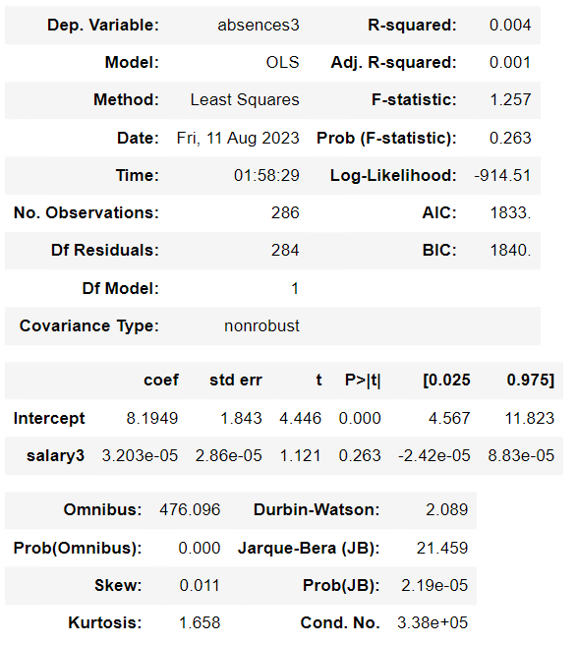
10) For this project, conduct a regression analysis on either one dependent and one explanatory variable, or multiple explanatory variables. Filtering out the outliers in salary and focusing on the team members less than $100000, the p-value comes much closer and now positive, however still does not show any statistical significance.

